Slide 1








GREEN
BUSINESS
Erasmus +
Leading Youth in Green Entrepreneurship

Slide 2





Definition
“Green businesses incorporate principles of sustainability into their business decisions in order to reduce their negative impacts on the global or local environment. They do this by selling environmentally friendly products or by greening their processes to make them more environmentally sustainable”

Slide 3



Why Green Business Matters in Today’s World?
Stay ahead of environmental regulation
Environmental regulation is becoming more and more stringent. Green businesses can reap the benefits
of staying ahead of environmental regulation.
Access new markets
There is an increasing demand for green products and services worldwide
Access to finance
Green businesses may be able to attract certain types of financing options for their green business ideas
that are not be available for conventional business ideas.
Reduce costs
These cost reductions
generally arise from efficiency gains when less inputs are required to produce the same output.
Improve quality
Green products and services can
therefore improve the value proposition of the enterprise and improve its bottom line

Slide 4

Why Green Business Makes Economic Sense?
Competitive Advantages
ESG and Investment Trends
Enhanced Brand Loyalty
Green business practices provide economic benefits like cost savings through energy efficiency, innovation in eco-friendly products, and increased consumer appeal by attracting sustainability-focused customers.
Companies with strong Environmental, Social, and Governance (ESG) profiles tend to attract better financing opportunities, drawing in investors who are increasingly focused on sustainability.
Green businesses often build stronger brand loyalty by aligning with customers' values and commitments to sustainability.

Slide 5
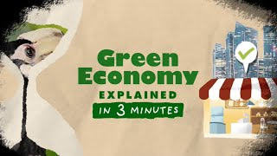
Green economy| Explained in 3 Minutes

Slide 6
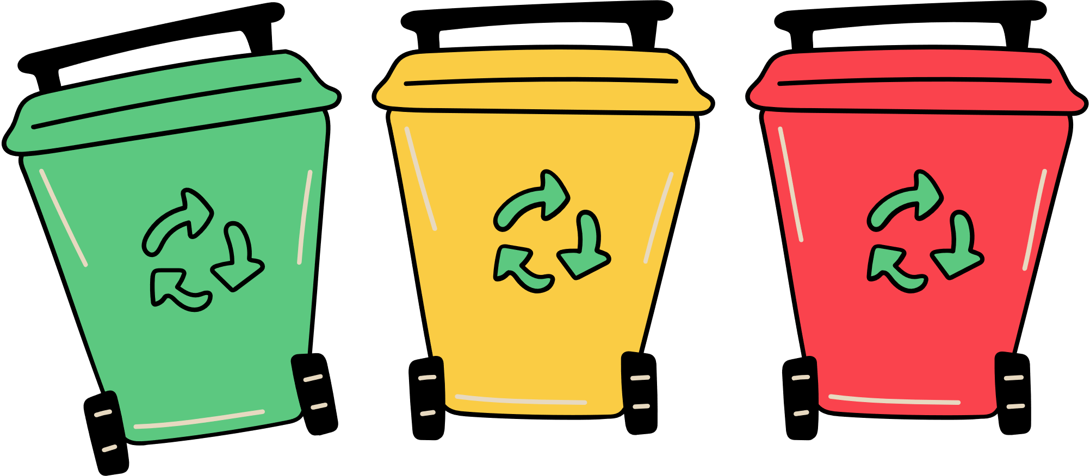
Empowering the Next Generation of Sustainable Entrepreneurs
Instilling Environmental Responsibility
Preparing for Future Green Career
Fostering Critical Thinking
  Inspiring Innovation
Equipping students with knowledge about green business prepares them for careers in emerging eco-friendly industries.
Encourages young people to think critically about corporate responsibility and ethical practices, shaping them into responsible future leaders.
Educating youngsters about green business inspires them to develop innovative solutions for environmental challenges, fueling future advancements in sustainability.
Teaching kids about sustainability helps them develop a sense of environmental management from an early age.

Slide 7


Incorporating Sustainability into Education
  Curriculum Integration: Include green business principles and environmental topics across various subjects like science, economics, and social studies.
  Project-Based Learning: Encourage students to work on projects that focus on sustainable solutions and innovations.
  Real-World Examples: Use case studies and examples from green businesses to illustrate practical applications of sustainability.
  School-Wide Initiatives: Implement sustainability practices within the school, such as recycling programs and energy-saving measures, to reinforce lessons.
  Guest Speakers: Invite professionals from the green sector to share insights and career opportunities in sustainability.
  Digital Resources: Utilize online tools and platforms for virtual learning about sustainability and green business.

Slide 8
Thank you for attending

